Slide 1
Spring MVC Framework
Java Center of Excellence

Slide 2
Objectives
History
Existing Frameworks
Need for Spring
Notes:
For different experience, people will have different expectations. At the beginning of the training itself, it is recommended that the expectations are made clear:
Beginner resources will find most of this very new and heavy
Experienced resources may already be familiar with some or many of these concepts

Slide 3
Handling the request with a HandlerMapping
Given a URL, figures out what Controller to use:
SimpleUrlHandlerMapping
  define mappings with Map or Properties
BeanNameUrlHandlerMapping
  bean names have same names as URL
CommonsPathMapHandlerMapping
  use Commons Attributes to determine mapping
ControllerClassNameHandlerMapping
  using the controller’s class name as the basis for the URL.

Slide 4
Selecting a view with a ViewResolver
Given a view name, figures out what View to use:
BeanNameViewResolver
  Spring beans happen to have the same name
UrlBasedViewResolver
  view name maps to a URL (like a filename)
ResourceBundleViewResolver
  look up the View in a resource file
XmlViewResolver
  uses XML file to determine mappings
FreeMarkerViewResolver
  UrlResourceViewResolver preset for FreeMarkerView
InternalResourceViewResolver
  UrlResourceViewResolver preset for InternalResourceView
VelocityViewResolver
  UrlResourceViewResolver preset for VelocityView

Slide 5
Different Views
Plenty of Views are packaged with Spring MVC:
JstlView
  map to a JSP page
RedirectView
  Perform an HTTP Redirect
TilesView, TilesJstlView
  integration with tiles
VelocityLayoutView, VelocityToolboxView, VelocityView
  Integration with the Velocity templating tool
FreeMarkerView
  use the FreeMarker templating tool
JasperReportsView, JasperReportsMultiFormatView, JasperReportsMultiFormatView, JasperReportsPdfView, JasperReportsXlsView
  Support for Jasper Reports

Slide 6
Localization
The locale may be chosen manually, selected by the browser, or fixed
  AcceptHeaderLocaleResolver - use the HTTP accept-header to determine the locale
  CookieLocalResolver - set the chosen locale in a cookie
  FixedLocaleResolver - always use a fixed locale (set in the config file)
  SessionLocaleResolver - store the chosen locale in the session
The spring tag <spring:message> picks the resource
Define the bean messageSource with a MessageSource to set the resources:
  StaticMessageSource - set messages within the object
  ResourceMessageBundleMessageSource - load messages from .properties files
  ReloadableResourceMessageBundleMessageSource - same as above, but reloads!
  (others)

Slide 7
Other Provided Controllers
Spring MVC includes lots of Controllers to extend from:
AbstractController
  basic controller, knows about caching, turning on/off get/set/post/head
ParameterizableViewController
  always go to the same view
UrlFileNameViewController
  parses the URL to return a view (http://blah/foo.html -> foo)
SimpleFormController
  for form handling, hooks for attaching commands, validator
AbstractWizardFormController
  easy wizard controller
ServletWrappingController
  delegates to a servlet

Slide 8
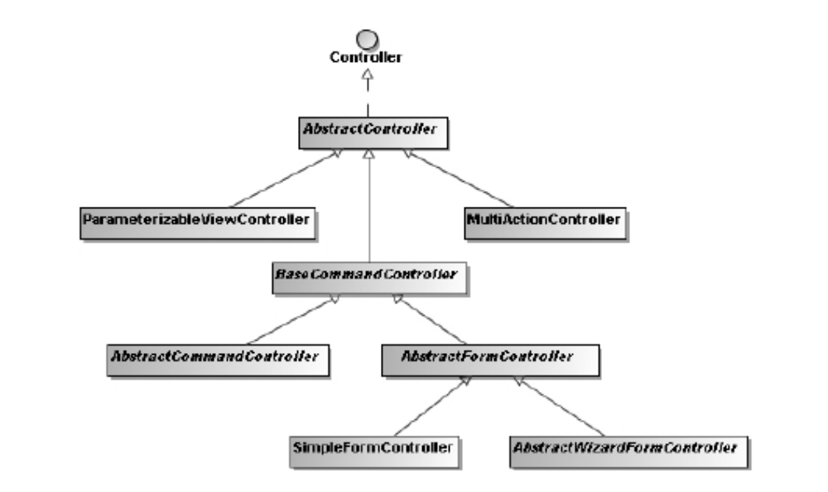
Common Controllers

Slide 9
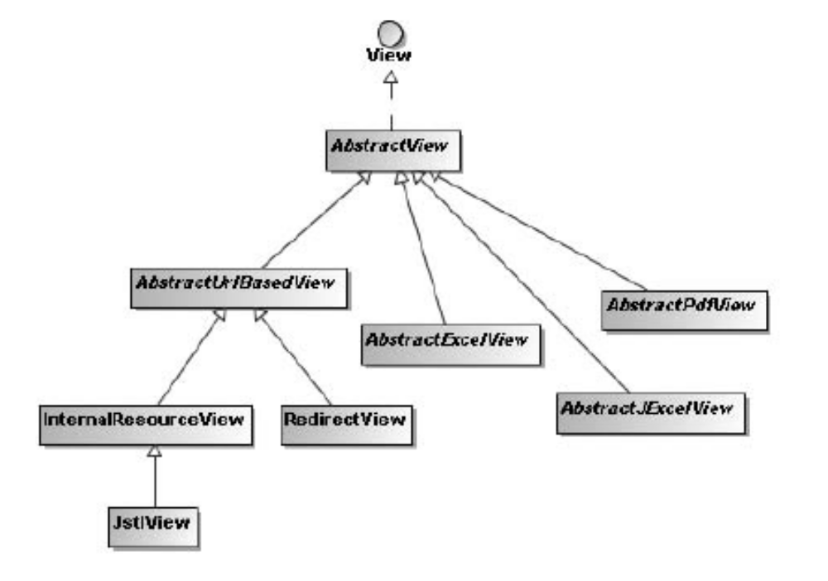
Common View Types

Slide 10
Handling Forms
Set the Command (just a bean)
Set a Validator if needed (extend org.springframework.validation.Validator)
Set destination views (form, success, failure, error)
By default, uses GET/POST to determine whether it needs to load the form or process it

Slide 11
Example: Form Processing
What are we going to build?
  A form to create a new car.
Form Controller
A form controller has two roles: initialize the form's initial values and process/persist the user input:
Command
A Command object is used to store the form values: it's equivalent to a Struts Action Form. However, it doesn't have to extend nor implement anything. So it's even possible to directly use the model class! (Car in our example)

Slide 12
Example contd.
Manager Classes
  method to create a car in 'WEB-INF/src/springmvc/service/CarManager.java'
public Car createCar(Car c) {
Car car = new Car();
car.setId((long)carList.size() + 1);
car.setBrand(c.getBrand());
car.setModel(c.getModel());
car.setPrice(c.getPrice());
carList.add(car);
return car;
}

Slide 13
Need a manager for brands, 'WEB-INF/src/springmvc/service/BrandManager.java':
public class BrandManager {
private static List<Brand> brandList;
static {
Brand brand1 = new Brand();
// Add brands to list after calling setters
brandList.add(brand2);
}
public List<Brand> getBrandList() {
//Code
}
public Brand getBrandById(Long id) {
//Code
}
}

Slide 14
Controller
In 'WEB-INF/springmvc-servlet.xml', we declare a new URL and its Controller:
  <bean name="/new_car.html" class="springmvc.web.CarNewController">
  <property name="commandClass" value="springmvc.model.Car"/> <property name="formView" value="carNew"/>
  <property name="successView" value="list_cars.html"/>
  </bean>
commandClass: the Command class
formView: the form view name
successView: where we go after the form has been successfully submitted

Slide 15
Controller
Create this Controller: 'WEB-INF/src/springmvc/web/CarNewController.java':
public class CarNewController extends SimpleFormController {
protected Object formBackingObject(HttpServletRequest request) throws Exception {
//TODO
}
protected Map referenceData(HttpServletRequest request) throws Exception {
//TODO }
protected void initBinder(HttpServletRequest request, ServletRequestDataBinder binder) throws Exception {
//TODO }
public ModelAndView onSubmit(Object command) throws ServletException {
//TODO
}
}

Slide 16
Controller Methods
Methods called before form is displayed
  formBackingObject: initialize the Command used to init the form.
  referenceData: set the view attributes (using a Map)
Methods called before form is displayed
  initBinder: prevent Spring to do some bindings and so them by ourselves if needed. Here we used the brand id parameter to set the actual Brand.
  onSubmit: the main code. In this case, we used the command object, which is a Car, to create a new Car.

Slide 17
View
Create the view 'jsp/carNew.jsp':
<%@ taglib prefix="c" uri="http://java.sun.com/jsp/jstl/core" %>
<%@ taglib prefix="form" uri="http://www.springframework.org/tags/form" %>
<html>
<body>
<h1>New Car</h1>
<form:form method="post">
Brand<br />
<form:select path="brand">
<form:options items="${brandList}" itemLabel="name" itemValue="id" />
</form:select>
<br /><br />
Model<br />
<form:input path="model"/><br /><br />
Price<br />
<form:input path="price"/><br /><br />
<input type="submit" value="Submit">
</form:form>
</body>
</html>

Slide 18
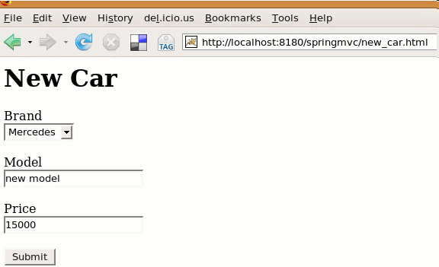
Result
We rebuild (ant), relaunch Tomcat and check it's working: http://localhost:8180/springmvc/new_car.html

Slide 19
Quick comparision with Struts
Controller code is divided between several methods to override only when necessary
Model beans can be used as form beans: no extra classes to write. For complex attributes (like brand in our example), we can override Spring and do these bindings by ourselves.
xml configuration is clear and straightforward

Slide 20
Form Validation
Use Case: User input validation for the new car form.
Validator class will validate a Car: 'WEB-INF/src/springmvc/validator/CarValidator.java'
package springmvc.validator;
import org.springframework.validation.Errors;
import org.springframework.validation.ValidationUtils;
import org.springframework.validation.Validator;
import springmvc.model.Car;
public class CarValidator implements Validator {
public boolean supports(Class aClass) {
return Car.class.equals(aClass);
}
public void validate(Object obj, Errors errors) {
Car car = (Car) obj;
// Insert some validations for Car
}
}

Slide 21
Key Methods
supports(): declare classes supported by this validator
To add an error these parameters are needed:
  Car field name
  error message key
  default message if no message is not found for the key

Slide 22
View Updates
<%@ taglib prefix="c" uri="http://java.sun.com/jsp/jstl/core" %>
<%@ taglib prefix="form" uri="http://www.springframework.org/tags/form" %>
<html>
<head>
<title>New Sponsor</title>
<style>
.error {
color: red;
}
</style>
</head>
<body>
<h1>New Car</h1>
<form:form method="post">
Brand<br />
<form:select path="brand">
<form:options items="${brandList}" itemLabel="name" itemValue="id" />
</form:select>
<br /><br />
Model <form:errors path="model" cssClass="error"/><br />
<form:input path="model"/><br /><br />
Price <form:errors path="price" cssClass="error"/><br />
<form:input path="price"/><br /><br />
<input type="submit" value="Submit">
</form:form>
</body>
</html>

Slide 23
Configuration
Declare the validator for the URL addCar.html in 'WEB-INF/springmvc-servlet.xml'
<bean name="/new_car.html" class="springmvc.web.CarNewController">
<property name="commandClass" value="springmvc.model.Car"/>
<property name="formView" value="carNew"/>
<property name="successView" value="list_cars.html"/>
<property name="validator">
<bean class="springmvc.validator.CarValidator"/>
</property>
</bean>

Slide 24
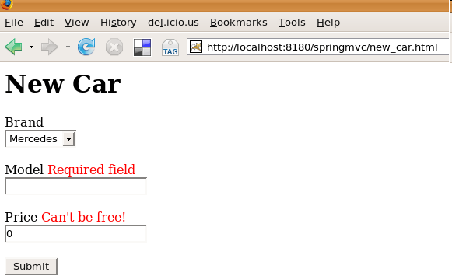
Result
Build (ant) and relaunch Tomcat: http://localhost:8180/springmvc/new_car.html

Slide 25

Try on your own

Slide 26
Wizards
Similar to Forms, but needs to validate along the way
One Controller handles multiple pages
Process at the end
Cancel anywhere along the line

Slide 27
Interceptor
Some HandlerMappings allow you to call an interceptor before the controller
Useful for checking for session timeout, adding things to the request/session
Kind of like AOP, but for Controllers

Slide 28
ExceptionHandler
Spring philosophy says that most Exceptions should not be caught
ExceptionHandler determines what to do if an Exception is thrown through the Controller

Slide 29
Themes
Totally change look and feel of your application in one step!
Lets you point to different css, jsp, images

Slide 30
Exercise : Do it Youtself
Add Localization
Exception Handling
Wizard Support

Slide 31
Struts Support
ContextLoaderPlugin - Struts 1.1 PlugIn that loads a Spring application context for the Struts ActionServlet. This context will automatically refer to the root WebApplicationContext (loaded by ContextLoaderListener/Servlet) as parent.
ActionSupport and DispatchActionSupport are pre-built convenience classes that provide easy access to the context. These classes alleviate the need to build custom service locators.

Slide 32
Conclusion
Spring MVC offers
  Lots of flexibility
  Straightforward design
  Leverages Spring injection

Slide 33
Questions

